Slide 1

Repetition Structure II
for loop and flow control
Notes:
Here we go again – it’s another lesson on repetition structures. In the previous lesson, we whiled away our time by talking about while loops, and in terms of functionality, the while loop is the only loop you need. However, there is a very common programming task that is a little bit clumsy to do with a while loop, which is when you want to execute the loop a fixed number of times, such as exactly 5 times, or to process every item in a list. Although we can do it with a while loop by having a counter variable and adding to it until it hits the target number, this is slightly troublesome since you need to make sure to increment the counter properly.
For such cases, it is more convenient to use another type of selection structure, called a for loop.

Slide 2
Objectives
At the end of this lesson, you will be able to….
code using for loop
Notes:
And so in this lesson, we will cover the for loop. The format may seem a bit strange to you initially, but once you get used to it, you will find that the for loop is a really convenient tool to use in many cases.

Slide 3
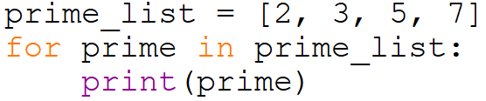
for Loop
Retrieve item from list
Executes the block of statements in the loop if there is item
Repeat from step 1 until all items in the list have been iterated
False
Next item
True
block of statements
for item in list:
statement
statement
Notes:
How does the for loop work? In English, it implements the logic of “for each item in a list, do something”. For example, for each item in this all-you-can-eat buffet, sample one item. It’s the Singaporean way.
This flowchart shows how the for loop works. Given a list, Python tries to retrieve the next item. If this is successful, it will execute the block of statements in the loop body, and then go back to try to retrieve the next item. This continues until the retrieval fails, which happens when you run out of items in the list, whereupon the loop ends. By default, the for loop will retrieve the items sequentially from the start to the end of the list.
This is how it is written in Python. For item in list colon, execute the statements that are indented below. For example, we could have this list prime_list, and this loop for prime in prime_list: print(prime). This program will print the numbers 2, 3, 5 and 7 in separate lines. Note that you can use any legal identifier in place of prime, and what happens is that in each iteration, that variable will take the value of the corresponding item in the list. This is why print(prime) works, because in each iteration prime takes the value of an item in the list.

Slide 4
range
range creates an immutable (non-modifiable) sequence type (list is also a sequence type) that represents arithmetic progression
To generate the range sequence, range() is called.
range is especially useful when we need to iterate over a sequence of numbers in loops
Notes:
But wait, what about executing a loop a fixed number of times, say, exactly 5 times? Well, that’s the same as going through a list with 5 items in it, so Python provides the range function. What range does is that it creates an immutable list, meaning you are not allowed to change the elements in the list. Inside this list is an arithmetic progression, which is a sequence of numbers where the difference between two successive numbers are the same throughout.
So what you need to do is tell the range function what kind of list you want to create, and then you can use the for loop to iterate through that list. Let’s see how we can do that.

Slide 5
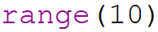
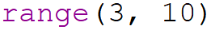
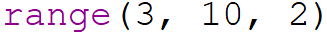
range
range(stop)
range(start, stop)
range(start, stop, step)
start: Starting number of the sequence
stop: Generate numbers up to, but not including this number
step: difference between each number
Parameters can be passed in range() to determine the range of sequence generated
All parameters must be integers
All parameters can be positive or negative
Notes:
The range function can take 1, 2 or 3 parameters. If it takes one parameter, that’s the stop value, and range will create a list containing integers starting from zero all the way up to but not including this number. So if we say range(10), the list containing 0, 1, 2, all the way up to 9 will be created. This is a very important thing to remember: the lists start from zero and end at one less than the stop value.
What if we don’t want to start at zero? Then we use two parameters, and the first parameter will be the start value. So range(3, 10) returns the list 3, 4, 5, all the way up to 9.
Finally, what if we don’t want the values to go up by 1? Then we can use a third parameter to define the step size. So range(3, 10, 2) returns the list containing 3, 5, 7, 9.
Oh, and range is pretty flexible. Although all parameters must be integers, all of them can be positive or negative. Let’s check out a few more examples.

Slide 6
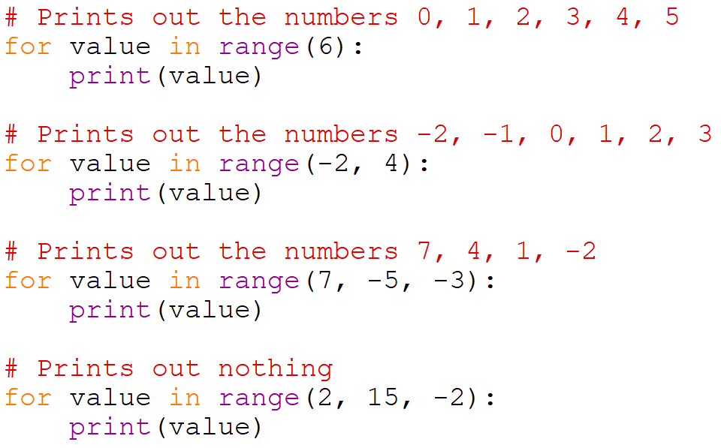
for Loop with range() - examples
Notes:
Take this piece of code – for value in range(6): print value. This will print out the numbers 0, 1, 2, 3, 4 and 5 in separate lines. Note once again that the list starts at zero and ends at 1 less than the stop value, which is 5, although the total number of iterations is 6.
The next piece of code prints out the values -2, -1, 0, 1, 2 and 3. As you can see, range can accept negative values.
The next piece of code demonstrates how you can use the step value to create a list of descending numbers. The function range(7, -5, -3) creates a list that starts from 7, and then keeps reducing the values by 3 until it hits -5. In this case, it will print 7, 4, 1, and -2. The next value would be -5, but since we never include the stop value, we don’t print -5 itself.
Finally, what happens if we do something weird like range(2, 15, -2)? That tells range to create a list starting from 2 and ending at 15, but reducing the value by 2 each time, so it will never reach 15. Will this be an error? Will it be an infinite loop? Turns out no, range returns an empty list and the loop just never runs. Bear this in mind – if you are writing a for loop but it never executes, it could be that the list is empty.

Slide 7
Temperature sensor example
A room is installed with a sensor that measures the temperature every hour.
Create a list that stores 24 temperature values.
For each of the following techniques, calculate the average temperature reading for the day.
1) Use a while loop
2) Use a for loop with range
3) Use a for loop
Notes:
Let’s take a look at an example with 3 possible solutions. Suppose the is a sensor in a room that measures the temperature every hour, and all 24 temperature values for one day are stored in a single list. Given this list, let’s try to calculate the average temperature reading for the day. We will do this three different ways: using a while loop, using a for loop with the range function, and using a for loop with the list directly.

Slide 8
Solution with while loop
temp_list = [ 20.1, 24, 27.3, 30.1, 26.4, 22.2, 20.1, 24, \
27.3, 30.1, 26.4, 20.1, 24, 27.3, 30.1, 26.4, \
20.1, 24, 27.3, 30.1, 26.4, 20.1, 24, 27.3 ]
total = 0
index = 0
while index < len(temp_list):
total += temp_list[index]
index += 1
average = total / len(temp_list)
Notes:
Let’s assume we have this list of floats called temp_list containing 24 temperature values. To get the average, we will need to total up all the values, then divide by 24. So we start with a variable called total initialized to zero, which we will use to keep a running total of all the temperature values. We then declare another variable index representing the index of the current item we are processing in the list. Then, while index is less than the length of temp_list, add the value of temp_list[index] to total, and then increment index by 1. In this way, we will go through element zero, one, all the way to element 23, adding each value to total. Then, when index becomes 24, it is no longer less than the length of the list, so the loop ends. Finally, we calculate the average by taking the total and dividing by the length of temp_list.
Since you are all experts on while loops, this code should make sense. In the next slide, let’s see how we can do the same thing using a for loop with the range function.

Slide 9
Solution with for loop using range
temp_list = [ 20.1, 24, 27.3, 30.1, 26.4, 22.2, 20.1, 24, \
27.3, 30.1, 26.4, 20.1, 24, 27.3, 30.1, 26.4, \
20.1, 24, 27.3, 30.1, 26.4, 20.1, 24, 27.3 ]
total = 0
for index in range (len(temp_list)):
total += temp_list[index]
average = total / len(temp_list)
Notes:
Once again, we set total to be zero. Next, we create the loop with “for index in range(len(temp_list)):”. Since there are 24 elements in temp_list, the range function will create a list containing the integers 0 to 23, and index will take each value in order inside the loop body. In each iteration, we increment total with the value at temp_list[index], so by the end of the loop, we will have totaled up all the temperature values. Finally, after the loop ends, we calculate the average.
This code looks a bit neater than our previous while loop since we do not have to manually set and increment the value of index.

Slide 10
Solution with for loop
temp_list = [ 20.1, 24, 27.3, 30.1, 26.4, 22.2, 20.1, 24,
27.3, 30.1, 26.4, 20.1, 24, 27.3, 30.1, 26.4,
20.1, 24, 27.3, 30.1, 26.4, 20.1, 24, 27.3 ]
total = 0
for temp in temp_list:
total += temp
average = total / len(temp_list)
Notes:
We can do this in another way, by traversing temp_list directly. Rather than using a value index to go through a list of integers and using it to index temp_list, we can instead use “for temp in temp_list:”. In this case, in each iteration, temp will contain the value of an element in temp_list, so we can just directly increment total by temp, and this loop will automatically end once we run out of elements in temp_list to traverse.
So, which method is best? The answer is, it depends. All three methods are correct, but depending on the specifics of the problem, one of them may be preferable. As you tackle more complex problems, use the method that fits the problem best.

Slide 11
Control Flow
break
continue
Notes:
Let’s end our lesson by revisiting our old friends break and continue. These two statements work exactly the same way in for loops as they do in while loops.
That’s it. Programming is easy.

Slide 12
Example 1 Temperature sensor using break
A room is installed with a sensor that measures the temperature at an hourly interval.
Create a list that stores 24 temperature readings.
With a for loop, check if any reading exceeds 25 degrees Celsius. If so, print a warning message and end the loop.
Notes:
Nah, we’re not going to end the lesson like that. Let’s go back to our temperature sensor example. Suppose we now want to write a for loop to check if any reading exceeds 25 degrees Celsius. If so, a warning message is printed and the loop ends.

Slide 13
Solution 1 using for loop and break
temp_list = [ 20.1, 24, 27.3, 30.1, 26.4, 22.2, 20.1, 24,
27.3, 30.1, 26.4, 20.1, 24, 27.3, 30.1, 26.4,
20.1, 24, 27.3, 30.1, 26.4, 20.1, 24, 27.3 ]
THRESHOLD_TEMP = 25
for temp in temp_list:
if (temp > THRESHOLD_TEMP):
print('Reading exceeded threshold')
break
Notes:
We can do it this way. We go through each value using a for loop. For each value temp in the list, we check if it is greater than the threshold temperature. If it is, we print a warning message and end the loop using the break statement.

Slide 14
Solution 2 using for loop with range and break
temp_list = [ 20.1, 24, 27.3, 30.1, 26.4, 22.2, 20.1, 24,
27.3, 30.1, 26.4, 20.1, 24, 27.3, 30.1, 26.4,
20.1, 24, 27.3, 30.1, 26.4, 20.1, 24, 27.3 ]
THRESHOLD_TEMP = 25
for i in range(0, len(temp_list)):
if (temp_list[i] > THRESHOLD_TEMP):
print('Reading exceeded threshold')
break
Notes:
Here is an alternative. Instead of using “for temp in temp_list”, we make use of range from 0 to the length of temp_list to access the values in temp_list using their index.

Slide 15
Example 2 Temperature sensor using continue
A room is installed with sensor that measures the temperature at an hourly interval.
Create a list that stores 24 temperature readings.
Then, for each of the following techniques, calculate the average temperature reading for the day.
With a for loop with continue, find the highest reading of the day.
Notes:
Here’s another example. Remember earlier when we were calculating the average temperature reading for the day? Now, what if we also want to find the highest temperature reading of the day at the same time? We could solve this problem using continue.

Slide 16
Solution 1 using for loop and continue
temp_list = [ 20.1, 24, 27.3, 30.1, 26.4, 22.2, 20.1, 24,
27.3, 30.1, 26.4, 20.1, 24, 27.3, 30.1, 26.4,
20.1, 24, 27.3, 30.1, 26.4, 20.1, 24, 27.3 ]
highest = 0
for temp in temp_list:
if (highest > temp):
continue
highest = temp
Notes:
Let’s assume that we will never get a temperature lower than zero. We are in Singapore after all, and our air cons are not that powerful. So in this code, we set the value of a variable highest to zero. We then go through each temp value in temp list and compare it with the current value of highest. If highest is greater than temp, then nothing needs to be done in this iteration, so we execute the statement continue. Otherwise, we know that temp is higher than the current value of highest, so we update highest with temp.

Slide 17
Solution 2 using for loop with range and continue
temp_list = [ 20.1, 24, 27.3, 30.1, 26.4, 22.2, 20.1, 24,
27.3, 30.1, 26.4, 20.1, 24, 27.3, 30.1, 26.4,
20.1, 24, 27.3, 30.1, 26.4, 20.1, 24, 27.3 ]
highest = 0
for i in range(0, len(temp_list):
temp = temp_list[i]
if (highest > temp):
continue
highest = temp
Notes:
And here is the corresponding code where we traverse temp_list using an index i instead.

Slide 18
Activity Break!
Lecture activities are in a separate file (Word document)
You are required to submit your solution for the activities in POLITEMall when you have completed all of them
Try to work on the activities now…
Notes:
Music from https://www.fiftysounds.com/royalty-free-music/marseille.html

Slide 19
Summary
A for loop can be used to iterate through a list of items
range can be used to generate a list containing an arithmetic progression
Use a for loop to iterate through a list created using range to have a loop run a fixed number of times
The break and continue statements work the same way as for while
Notes:
With that, we are done with for loops. We have gone through how a for loop can traverse through a list, and how we can use the range function with the for loop in order to have the loop iterate for a fixed number of times. Finally, we note that break and continue also works in for loops, just like for while loops.

Slide 20
Reading Reference
Python 3 Documentation
https://docs.python.org/3/reference/compound_stmts.html#for
Learn Python Tutorial
https://www.learnpython.org/en/Loops
Notes:
And now we are done with loops. Well, not really, because we also want to see what happens when we have loops within loops. It’s madness, madness I tell you!
Anyway, here are a couple of links you can follow if you would like to learn more about loops in Python. Until next time, remember to keep up with current events and trends. Because it’s important to always stay in the loop.

